Slide 1
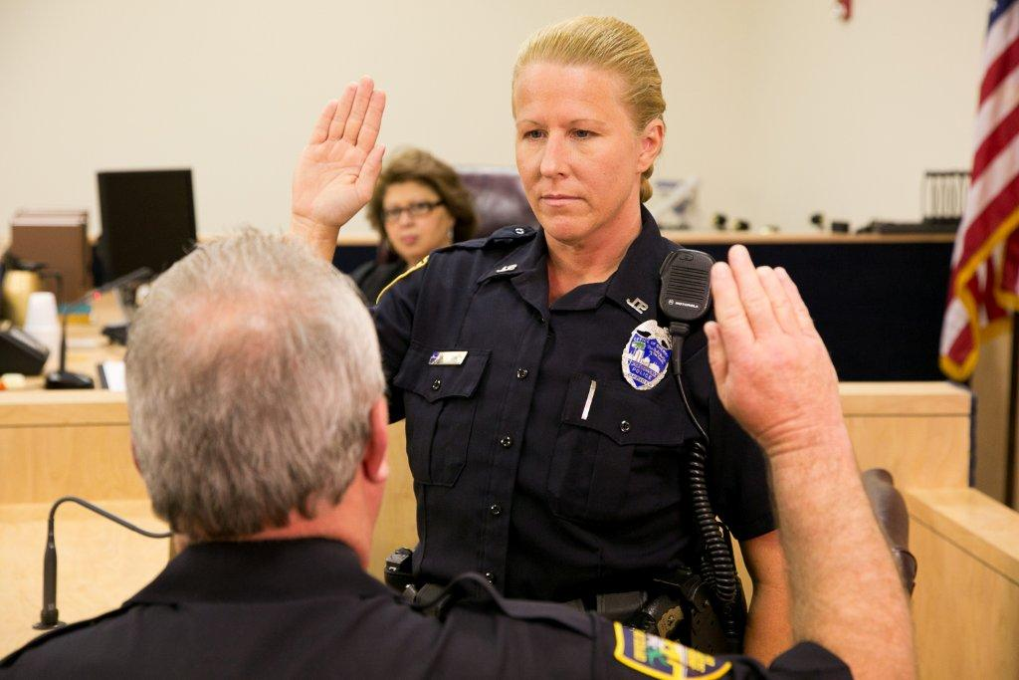



Session 12
Moot Court

Slide 2

Learning Objectives
  Discuss need for competent courtroom testimony
  Demonstrate proper techniques of courtroom testimony

Slide 3

Courtroom Testimony

Slide 4
Questions?

